Slide 1
2017 Conversationalists
20th Annual
Table Talk Luncheon
Presented by the
University of Houston
Friends of Women’s Studies

Slide 2
Farida Abjani CEO, Shining Nightingale

Slide 3
Nancy Almodovar CEO/President, Nan & Company Properties

Slide 4
Lauren Anderson Program Manager, ECE, & Former Principal Dancer, Houston Ballet

Slide 5
Keliy Anderson-Staley Assistant Professor of Photography/Digital Media, UH School of Art

Slide 6
Nory Angel Executive Director & CEO, SER-Jobs for Progress

Slide 7
Rhonda C. Arnold Chief Municipal Affairs Officer, Houston Airports

Slide 8
Decie Autin Vice President, Project Management & Execution, ExxonMobil Development Company

Slide 9
Devi Brown Radio Personality, iHeartmedia; CEO, Karma Bliss

Slide 10
Marcilynn Burke Associate Dean & Associate Professor of Law, UH Law Center

Slide 11
Ellen Cohen Councilwoman, Houston City Council, and Mayor Pro Tem

Slide 12
Minal Patel Davis Special Advisor to the Mayor on Human Trafficking, City of Houston

Slide 13
Shannon Deer Director, Full-Time MBA Program & Accounting Faculty, Texas A&M University

Slide 14
Mimi Del Grande Co-Owner, Café Annie

Slide 15
Susie Distefano Senior Vice President & CEO, Children’s Memorial Hermann Hospital

Slide 16
Sissy Farenthold Activist

Slide 17
Sameera Faridi Director/Designer, Poshak Fashion & Style

Slide 18
Debbie Ferguson-McKenzie, UH Women’s Track & Field Coach, 3-time Olympic Medalist

Slide 19
Julie Baker Finck, PhD President, Barbara Bush Houston Literacy Foundation

Slide 20
Irma Galvan Owner/Chef, Irma’s Restaurant

Slide 21
Beatrice Garza Former President/CEO, Association for the Advancement of Mexican Americans , Inc.

Slide 22
Leslie Gaworecki Table Talk 2017 Featured Artist

Slide 23
Winell Herron Group Vice President of Public Affairs, Diversity, & Environmental Affairs, H-E-B

Slide 24
Shezi Kirmani, MD Medical Director, My Pure MD, PLLC

Slide 25
Cheryl Mills Knight Brand Director, Kendra Scott Jewelry

Slide 26
Bonna Kol President, Asia Society

Slide 27
Rhea Lawson Director, Houston Public Library

Slide 28
Bridgette Shen Lee, OD Owner, Vision Optique

Slide 29
Nicole Longnecker Owner, Nicole Longnecker Gallery

Slide 30
Marian Luntz Curator, Film and Video, MFAH

Slide 31
Ann MacNaughton Wealth Management Advisor, Merrill Lynch

Slide 32
Nina Magon Creative Director/Principal, Contour Interior Design

Slide 33
Lisa Malosky Sports Journalist; CEO, LisaMaloskyProductions

Slide 34
Ashley McClellan CEO, The Woman’s Hospital of Texas

Slide 35
Martha Montalvo Executive Assistant Chief/Former Interim Chief, Houston Police Department

Slide 36
Chau Nguyen Chief Marketing Officer, Houston Area Women’s Center

Slide 37
Yudith Nieto Community Advocate, Texas Environmental Justice Advocacy Services (T.E.J.A.S.)

Slide 38
Linda Flores Olson Executive Director, Houston Hispanic Forum

Slide 39
Melanie Espinosa Pang Co-Chair, Mayor’s LGBTQ Advisory Board; Qualitative Research & Evaluation Manager, The Salvation Army

Slide 40
Annise Parker Former Houston Mayor; SVP & Chief Strategy Officer, Neighborhood Centers Inc.

Slide 41
Carrin Patman Board Chair, Houston METRO

Slide 42
Juanita Rasmus Pastor, St. John’s United Methodist Church

Slide 43
Maria Rios Founder/President/CEO, Nation Waste, Inc.

Slide 44
Dr. Martha Serpas, Poet, author of The Diener; Professor of English, University of Houston

Slide 45
Carrie Shoemake Founding Partner, GSMA Architects, Inc.

Slide 46
Carey Shuart Owner, Shuart Farms; Activist, Shuart Women’s Archive & Research Collection, UH

Slide 47
Deepi Sidhu Broadcast Journalist & Texans Insider, Houston Texans

Slide 48
Kavita Singh, PhD Assistant Professor of English/Caribbean Studies

Slide 49
Juliet Stipeche Director of Education, City of Houston

Slide 50
Paula Sutton Chairman of the Board, Interfaith Ministries for Greater Houston

Slide 51
Hannah Terry Associate Pastor, Fondren Apartment Ministry, Westbury United Methodist Church

Slide 52
Frances Valdez Owner, FValdezLaw PC

Slide 53
Amitha Verma CEO, Amitha Verma Home Decor

Slide 54
Kiran Verma Executive Chef/Owner, Kiran’s Restaurant

Slide 55
Dr. Alvia Wardlaw, Director/Curator, University Museum, Texas Southern University

Slide 56
Beth White President/CEO, Houston Parks Board

Slide 57
Andrea White Editorial Board, Houston Chronicle

Slide 58
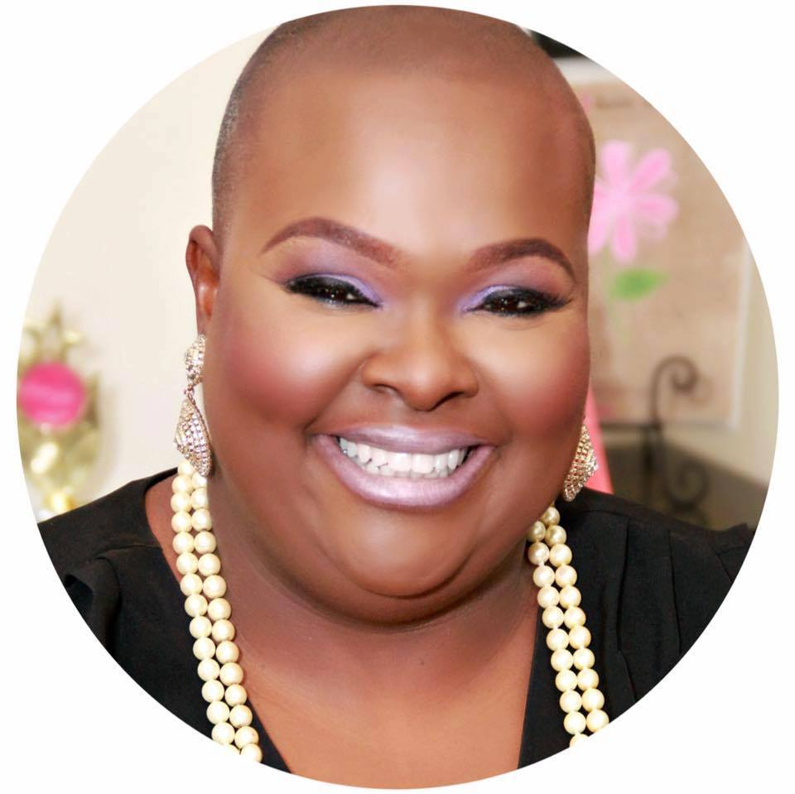
Dawniel Winningham President/CEO, Wealthy Sisters Network

Slide 59
Aimee Woodall Executive Director, The Black Sheep Agency

Slide 60
Lynn Wyatt Philanthropist

Slide 61
Kelly Zúñiga CEO, Holocaust Museum Houston

